Slide 1
7. Nearly Free Electron Model
Issues that are addressed in this chapter include:
The nearly free electron model
Bloch function description
The Kronig-Penney model
Wave equation of electron in a periodic potential

Slide 2
7.1 The Nearly-Free Electron Model
Deficiencies of the free electron model
The free electron model can quite accurately describe heat capacity, thermal conductivity, electrical conductivity, magnetic susceptibility and electrodynamics of metals
The free electron model fails in explaining the diffe-rences between metals, semimetals, insulators, etc.
Energy
insulators
metals
semiconductors

Slide 3
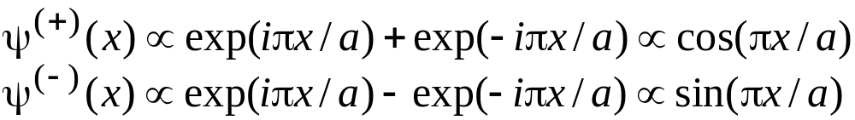
The nearly-free electron model
For the case of the free-electron model, the allowed energy values are essentially continuous and the corresponding wavefunctions are plane waves.
Note also that a Bragg reflection is a characteristic feature of the wave propagation. At the edge of the Brillouin zone one has reflection and the wavefunctions are composed of forward and backward propagating waves:
Also note that these two standing waves will pile-up electrons at different potential energy, which will then lead to the energy gaps concept.

Slide 4
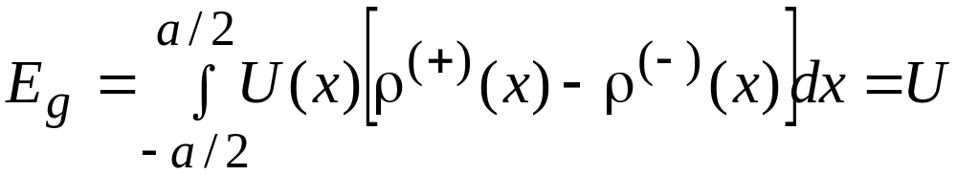
The energy expectation value difference between these two charge terms, for a potential energy term of the form
U(x)=Ucos(πx/a)
is:

Slide 5
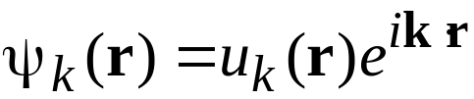
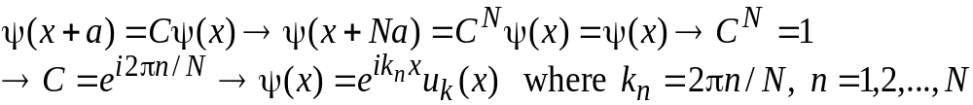
7.2 The Bloch function description
F. Bloch proved important theorem that the solutions to the Schrödinger equation for a periodic potential must be of a form:
We now give a simplified proof of the Bloch theorem, which assumes 1D lattice with atoms at positions x=0, a, 2a, …, Na, that are arranged on the ring. Guided by the symmetry of the ring, we now make the periodic assumption, that leads to:
plane-wave
component
cell periodic part with
periodicity of the lattice

Slide 6
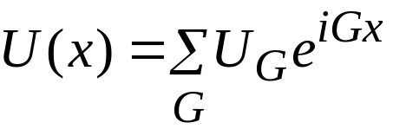
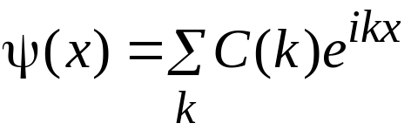
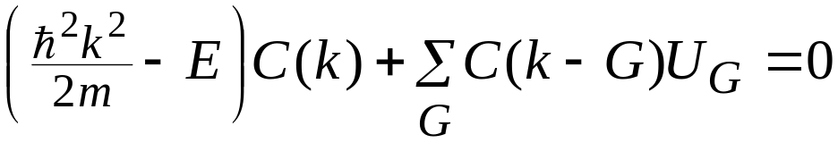
7.4 The wave equation in a periodic potential
Derivation of the central equation
Because of the periodicity of the potential, we can represent it in terms of the reciprocal lattice vectors G:
We now expand the wavefunctions in terms of their Fourier series components
Substituting the results for U(x) and for ψ(x) into the TISWE, we arrive at the following set of algerbraic equations:
Central
equation

Slide 7
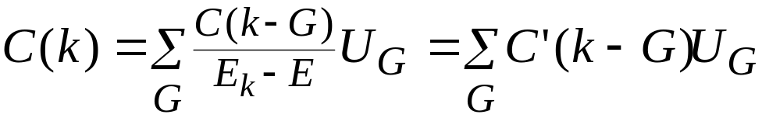
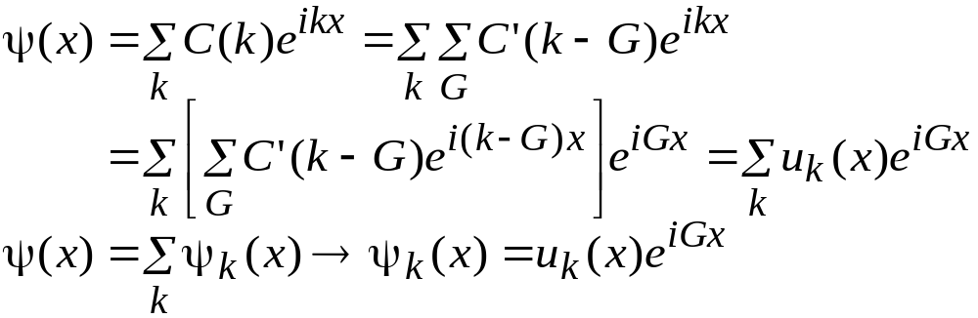
Restatement of the Bloch theorem
To achieve restatement of the Bloch theorem, we start from the solution of the central equation, of the form
and substitute this result back into the general expression for ψ(x) to get:
The validity of the above result is verified with:

Slide 8
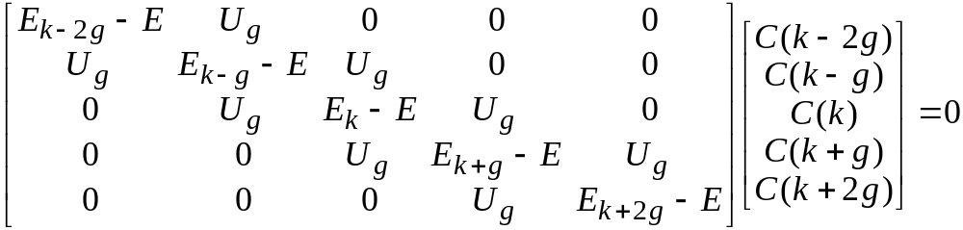
Solution of the central equation
The task here is to formulate the central equation to be solved as an eigenvalue problem.
Assumption: All the U_{G}’s are zero except for G=±g.
The set of equations that needs to be solved then is recast in the following matrix equation:
Notes:
At a given k, each root represents different band.
Most often k is taken in the first zone to reduce confusion in labeling.

Slide 9
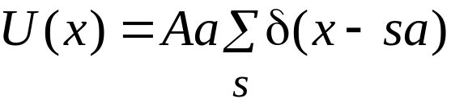
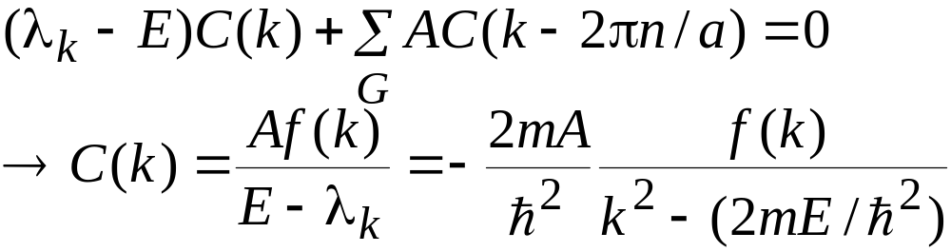
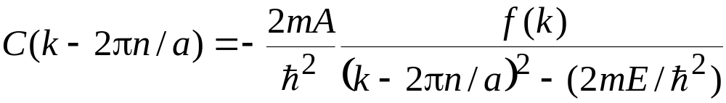
Kronig-Penney Model in Reciprocal Space
The assumption made is that the periodic potential is a series of delta-functions, i.e.
for which the Fourier series coefficient is U_{G}=A.
The central equation is now rewritten in the following manner:
Similarly:

Slide 10
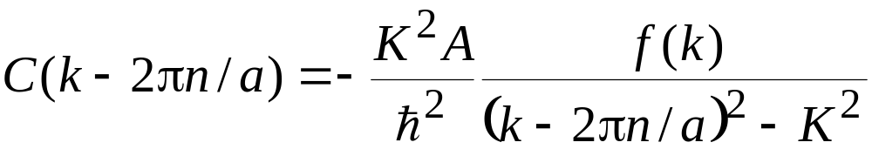
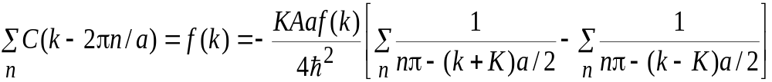
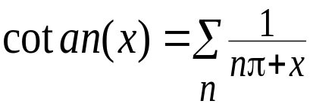
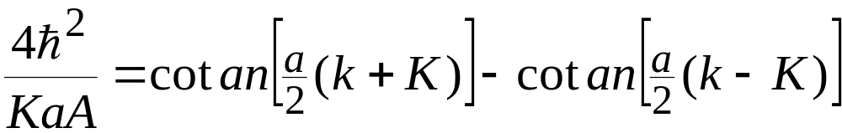
With the introduction of K²=2mE/h², we get:
The above expression, after rearranging and summing over n can be rewritten in the following form:
We now use the following identities:
to arrive at:

Slide 11
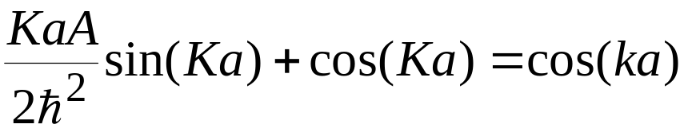
After trigonometric manipulation, we arrive at the following final expression:
This last expression is identical with the result obtained with the direct application of the Bloch theorem.
Empty Lattice Approximation
When plotting the energy band structure, it is convenient to start by calculating the free-electron energies back into the first Brillouin zone, i.e.
k’ + G = k
First Brillouin
zone
Unrestricted
wavevector
Appropriate reciprocal lattice vector

Slide 12
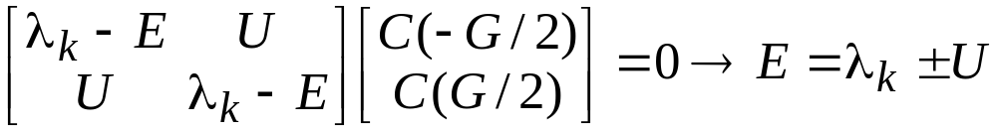
The approximate solutions near the zone boundary can be obtained by making the following approximations:
1.) Consider wavevector exactly at the zone boundary at G=2π/a.
2.) By solving for orbitals with wavevectors k near the zone boundary G/2.
Case 1:
For the case when k=±G/2, we arrive at:
Now, substituting back into one of the equations, we get:
C(-G/2)=±C(G/2)
One of these solutions gives wavefunction at the bottom of the gap, the other gives the wavefunction at the top of the gap. Which solution has lower energy depends upon the sign of U.

Slide 13
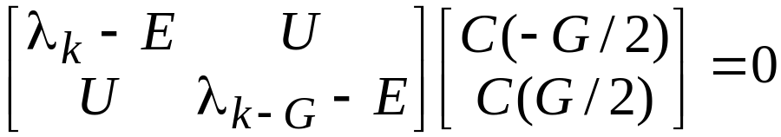
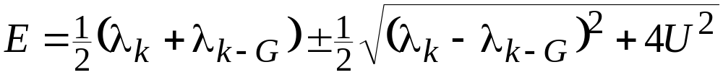
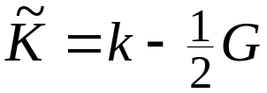
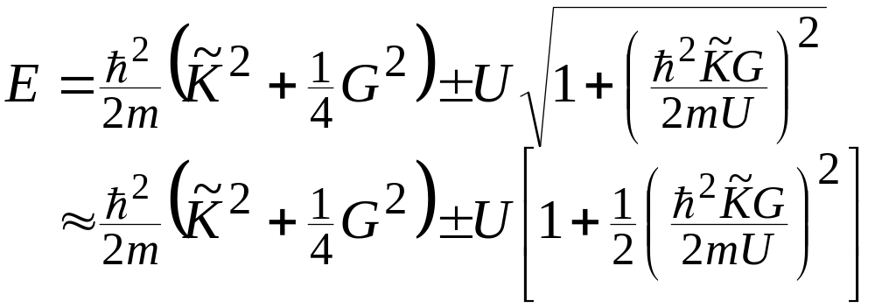
Case 2:
For this second case we solve the following set of equations:
The solutions of this set of equations are:
With the introduction of:
the above solution can also be rewritten as:

